Slide 1

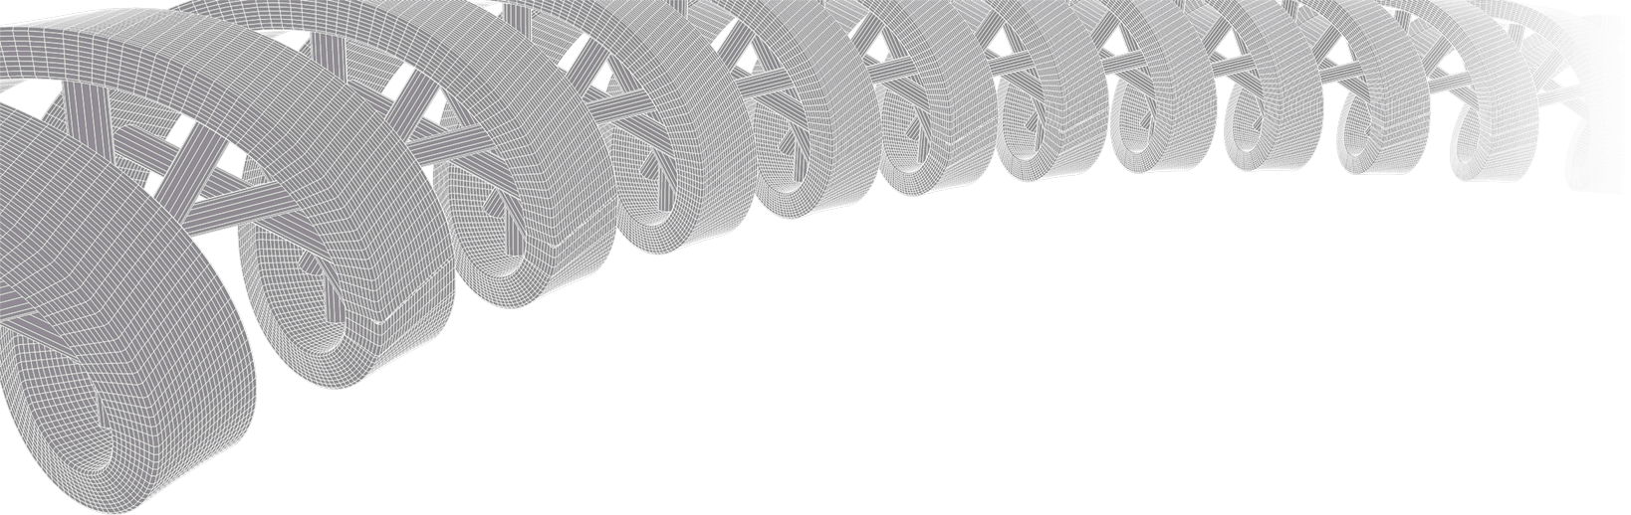

PMBIO Module 06 RNAseq. RNA-sequence analysis
Malachi Griffith, Obi Griffith, Zachary Skidmore, Huiming Xia
Introduction to bioinformatics for DNA and RNA sequence analysis (IBDR01)
29 October – 2 November, 2018
Glasgow

Slide 2
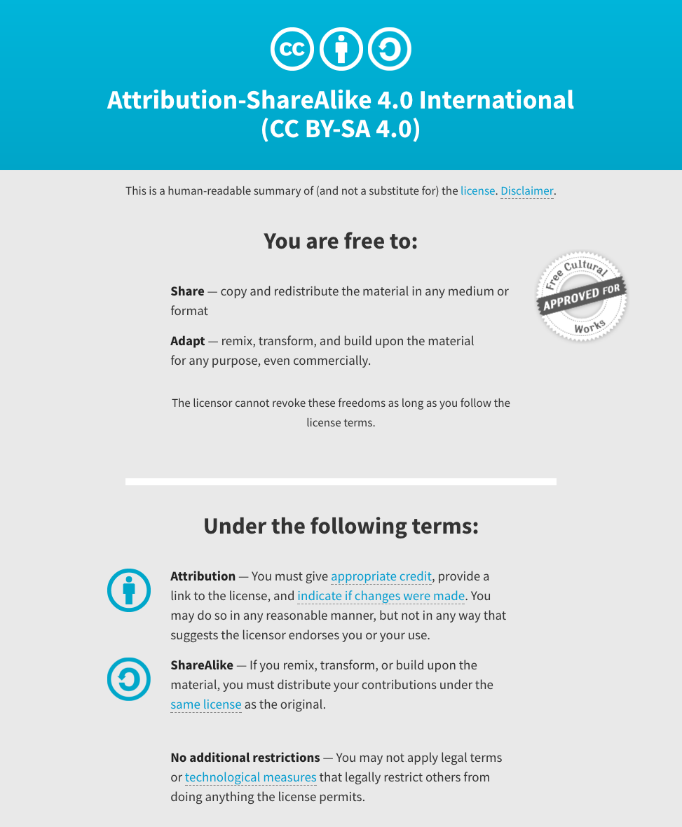
Notes:
Note there are two licenses if effect for this course.
All *content* (lectures, written materials, etc.) are made available under the Creative Commons Attribution-ShareAlike 4.0 International (CC BY-SA 4.0). (https://creativecommons.org/licenses/by-sa/4.0/).
All *code* (R scripts the website code itself) are made available under the MIT License (https://opensource.org/licenses/MIT).

Slide 3
Learning objectives of module 06: RNAseq
Key concepts: RNA-seq, library strategies, RNA splicing, genes and transcripts, transcription strand, gene/transcript abundance estimation, FPKM and TPM, differential expression (DE) analysis, normalization, batch effects
Perform alignment of RNA-seq data and a basic QC analysis of the resulting alignments
Obtain gene and transcript abundance estimates
Perform a reference-free alignment and abundance estimation and contrast the results with the reference based approach
Basic differential expression analysis
Perform an expression outlier analysis
Run an RNA fusion detection tool and parse the results for interesting candidates
Assess expression of specific gene markers of relevance (e.g. HER2, ER, PR)
Assess the expression of specific variants identified in previous sections.
Identify an example of allele specific expression

Slide 4
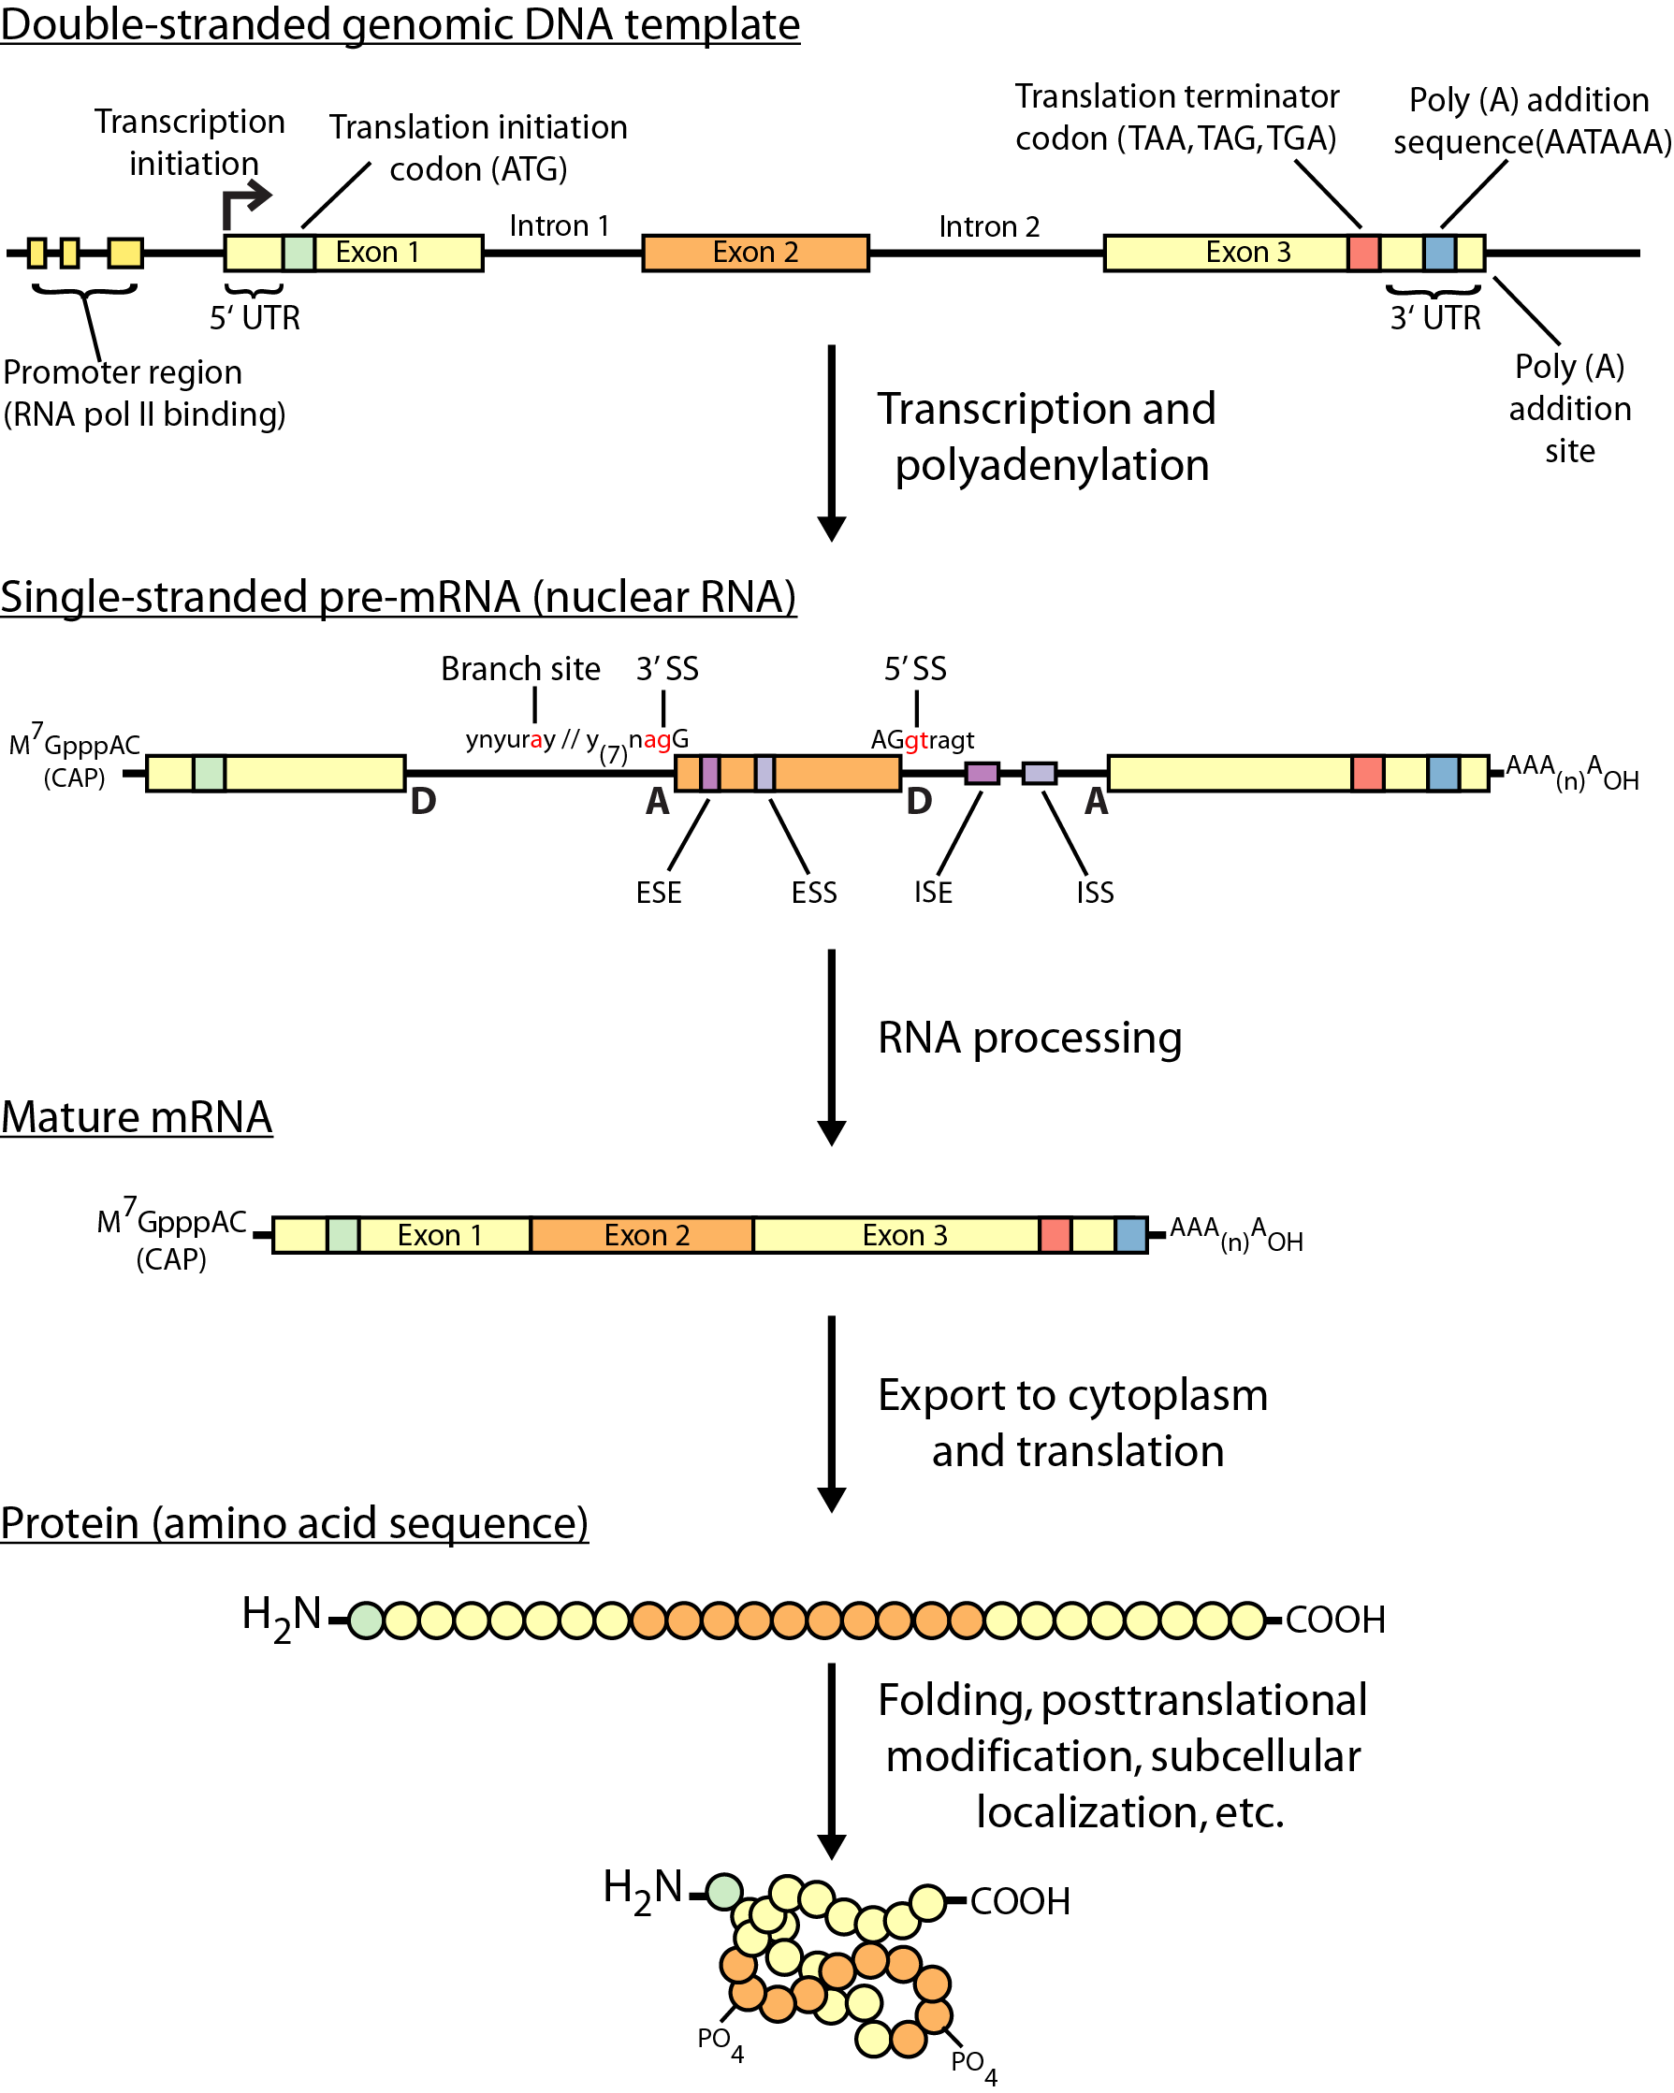
Gene expression

Slide 5
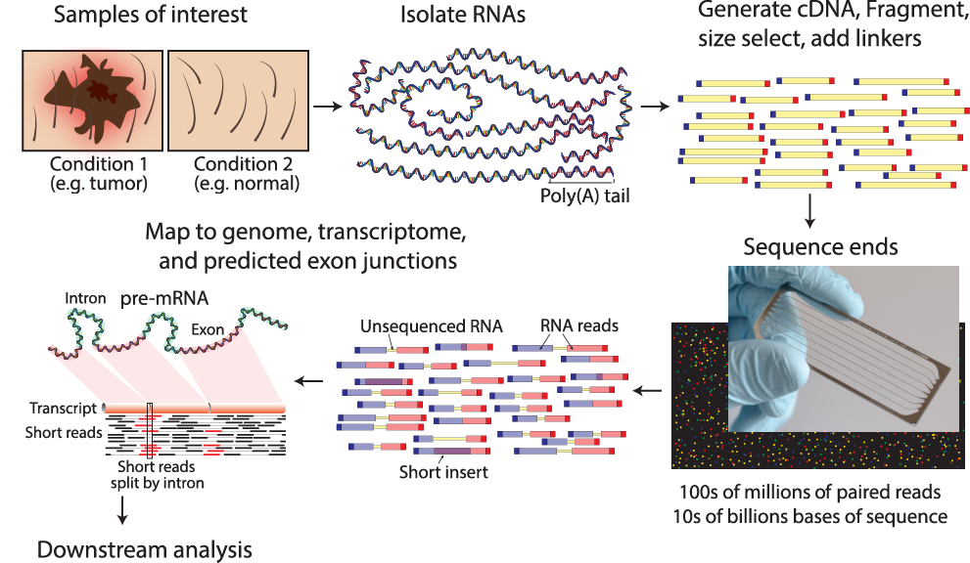
RNA sequencing
Notes:
Notes on paired end read depiction:
Each line depicts a sequenced fragment. These consist of adapters, and portions sequenced from each end
Blue is being used to indicated read 1, and red for read 2
If the fragment is long enough relative to the read sequence length, there will be a portion in the middle that is not sequenced
Read1 and Read2 can also overlap
Note the portion

Slide 6
Challenges
Sample
Purity?, quantity?, quality?
RNAs consist of small exons that may be separated by large introns
Mapping reads to genome is challenging
The relative abundance of RNAs vary wildly
10⁵ – 10⁷ orders of magnitude
Since RNA sequencing works by random sampling, a small fraction of highly expressed genes may consume the majority of reads
Ribosomal and mitochondrial genes
RNAs come in a wide range of sizes
Small RNAs must be captured separately
PolyA selection of large RNAs may result in 3’ end bias
RNA is fragile compared to DNA (easily degraded)

Slide 7
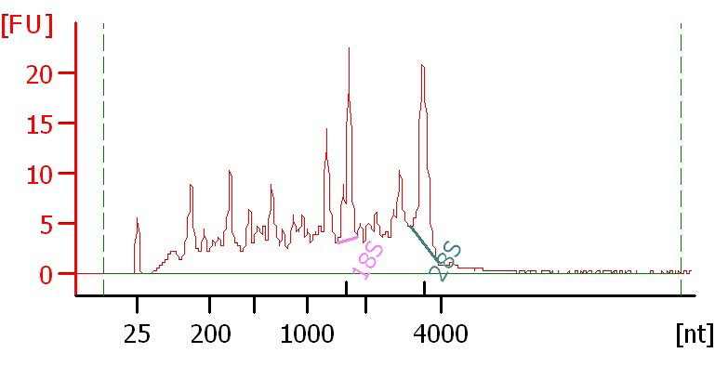
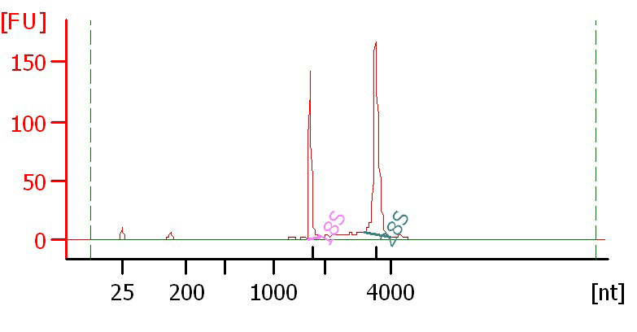
Agilent example / interpretation
https://goo.gl/uC5a3C
‘RIN’ = RNA integrity number
0 (bad) to 10 (good)
RIN = 6.0
RIN = 10

Slide 8
There are many RNA-seq library construction strategies
Total RNA versus polyA+ RNA?
Ribo-reduction?
Size selection (before and/or after cDNA synthesis)
Small RNAs (microRNAs) vs. large RNAs?
A narrow fragment size distribution vs. a broad one?
Linear amplification?
Stranded vs. un-stranded libraries
Exome captured vs. un-captured
Library normalization?
These details can affect analysis strategy
Especially comparisons between libraries

Slide 9
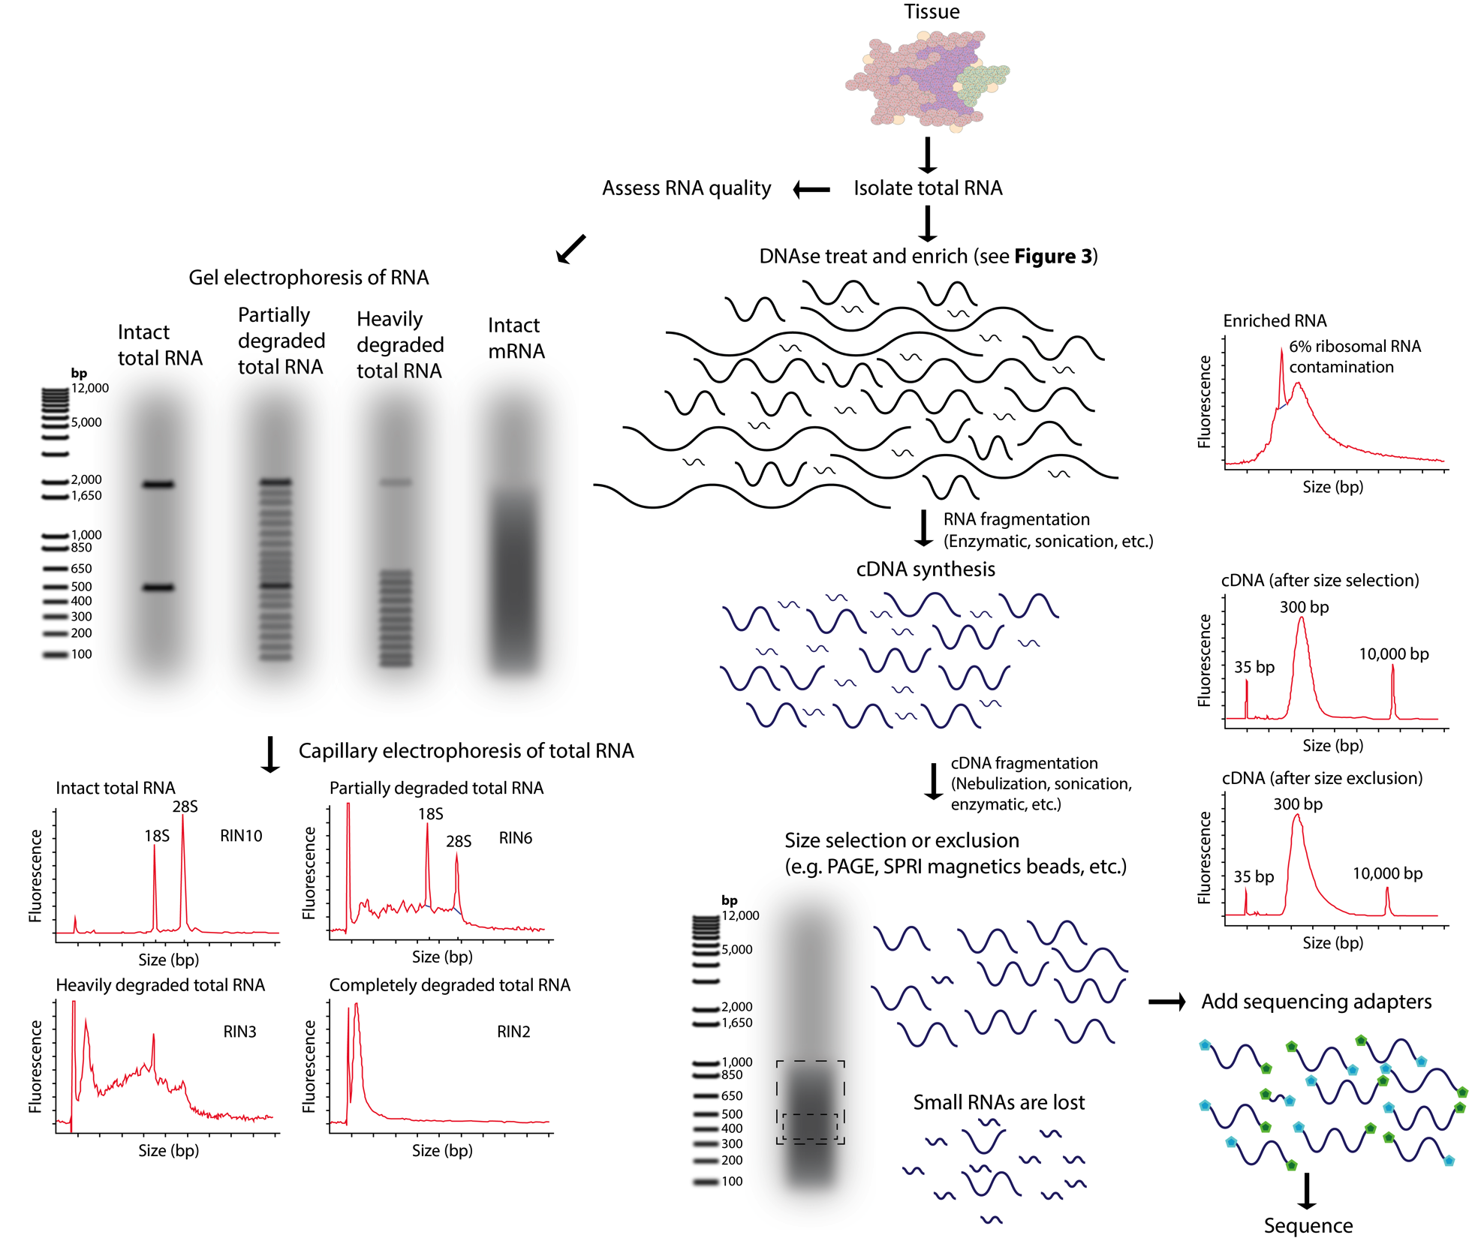
Fragmentation and size selection
Notes:
- RNA-seq library construction may involve both fragmentation and size selection. These procedures may be modified according to the integrity and amount of starting total RNA. The distributions of RNA molecule sizes are depicted for input total RNA and at various stages during the process of RNA/cDNA fragmentation and size selection. Commonly used methods for fragmentation and size selection are depicted along with the expected output of a quality-control assay at each stage (in the form of a capillary electrophoresis trace). Note that in the final library, it is typical that the majority of RNAs below a certain size (typically <150–200 bp) are underrepresented. Refer to S3 Table and S7 Table for more details on many of the concepts depicted in this figure.

Slide 10
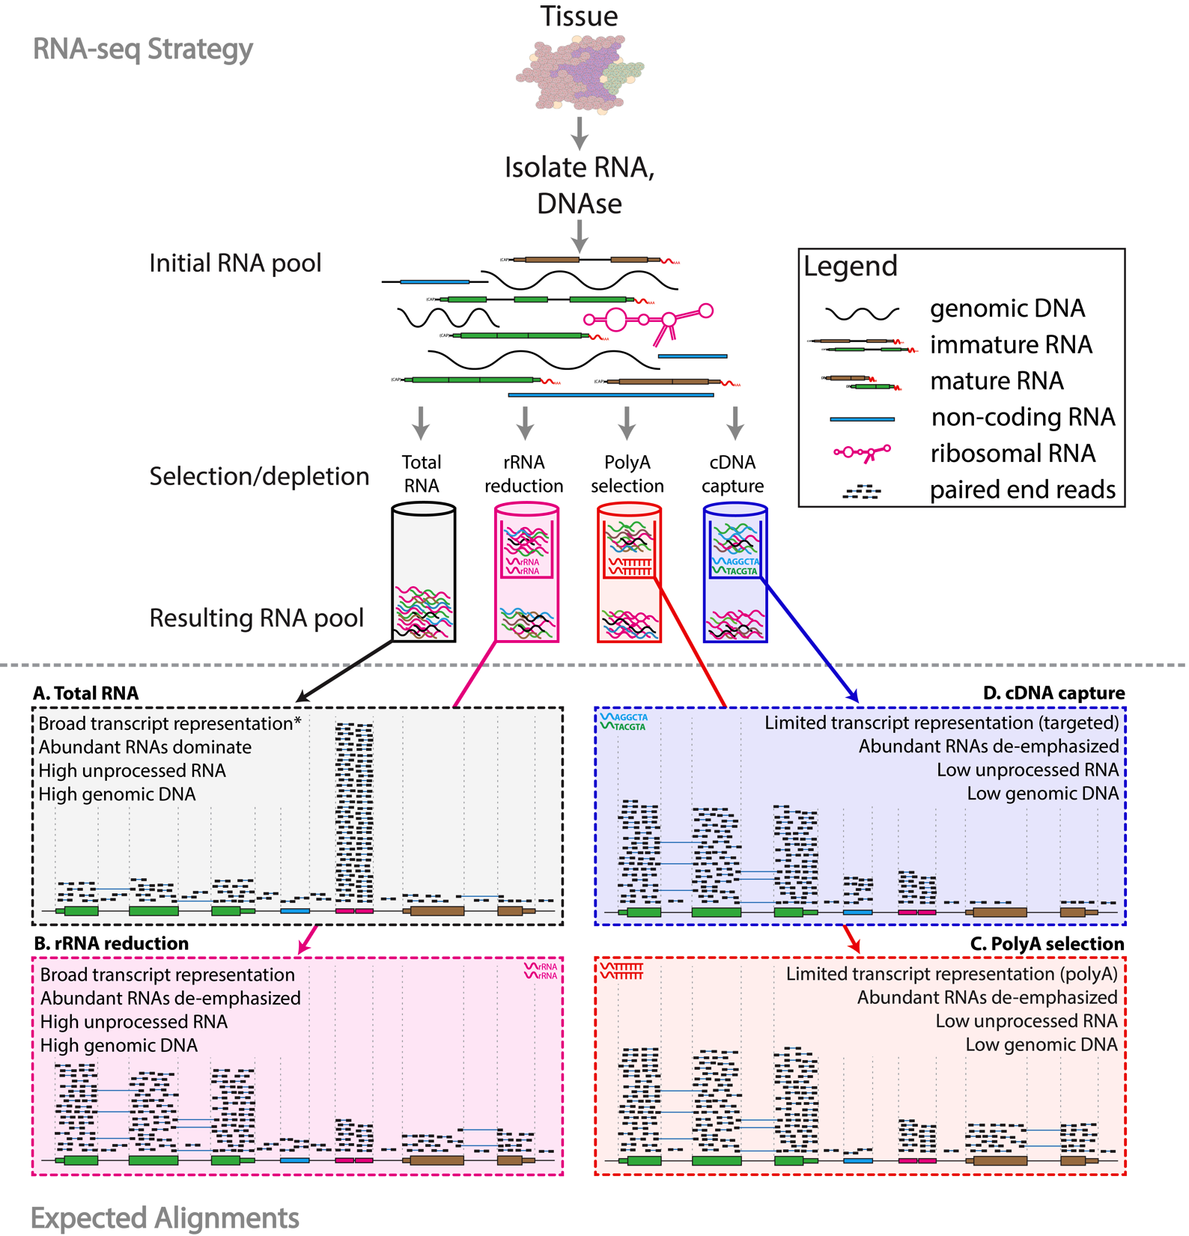
RNA sequence selection/depletion
Notes:
RNA-seq library enrichment strategies that influence interpretation and analysis. RNA-seq library construction protocols differ widely, and these differences have significant consequences for data interpretation and analysis. The figure above illustrates representative alignment results for either total RNA or one of three commonly used enrichment strategies at a hypothetical genomic locus with very highly expressed ribosomal RNA (pink), highly expressed protein coding (green), lowly expressed protein coding (brown) and lowly expressed noncoding RNA (blue) genes. (A) If total RNA is sequenced without enrichment, the vast majority of reads correspond to a small number of very highly expressed RNA species such as ribosomal RNAs (rRNAs). In humans, ~95%–98% of all RNA molecules may be rRNAs. A significant amount of genomic DNA (gDNA) and unprocessed heteronuclear RNA (hnRNA, also known as pre-mRNA) contamination may also remain after typical RNA isolation procedures. As a result, most reads will align to intronic, intergenic, and especially to ribosomal gene regions. Since analysis of these molecules is rarely the target of RNA-seq, various enrichment strategies are commonly employed. The amount of gDNA contamination in total RNA can be reduced, but not entirely eliminated, by use of a deoxyribonuclease (DNase) treatment. The amount of unprocessed RNA can be reduced, but not entirely eliminated, by employing an RNA isolation method that attempts to keep nuclei intact and removing these to enrich for mature mRNAs present in the cytoplasmic compartment. Additional strategies are discussed in S3 Table.
* When sequencing total RNA, a complete representation of the transcriptome is theoretically present, but in practical terms, insufficient sequence reads are obtained to sufficiently sample all transcripts of all types, and some enrichment strategy is required to reduce extremely abundant rRNA species. (B) Selective rRNA reduction kits use oligonucleotides complementary to ribosomal sequences to specifically reduce the abundance of rRNAs while maintaining a broad representation of transcript species. Since the oligonucleotide probes used in these kits are only designed to bind to and deplete rRNA sequences, a significant amount of unprocessed RNA and gDNA contamination may remain. (C) Poly(A) selection and (D) cDNA capture methods specifically enrich for (primarily) mature polyadenylated RNA species or specific targets (e.g., all known transcript exons), respectively. Since poly(A) selection specifically targets RNAs that have been polyadenylated—a modification that happens at the end of the transcription process—poly(A) selection results in an enrichment for mature, completely processed RNAs. Poly(A) selection and cDNA capture methods sacrifice some transcriptome representation for increased signal to noise for transcripts of greater interest. Poly(A) methods will fail to represent most noncoding and other nonpolyadenylated RNAs. Capture methods on the other hand will under-represent any loci not specifically included in the capture design. For example, in this case the brown gene was not included in the design, and therefore, expression of this gene would be underestimated. Each of the methods depicted here has advantages and disadvantages (S3 Table and S7 Table). Furthermore, the relative amounts of each class of RNA depicted in each panel are hypothetical examples meant to demonstrate the goals and principles of each enrichment strategy and should not be interpreted quantitatively. Refer to S4 Table for additional information on the effect of each enrichment strategy.

Slide 11
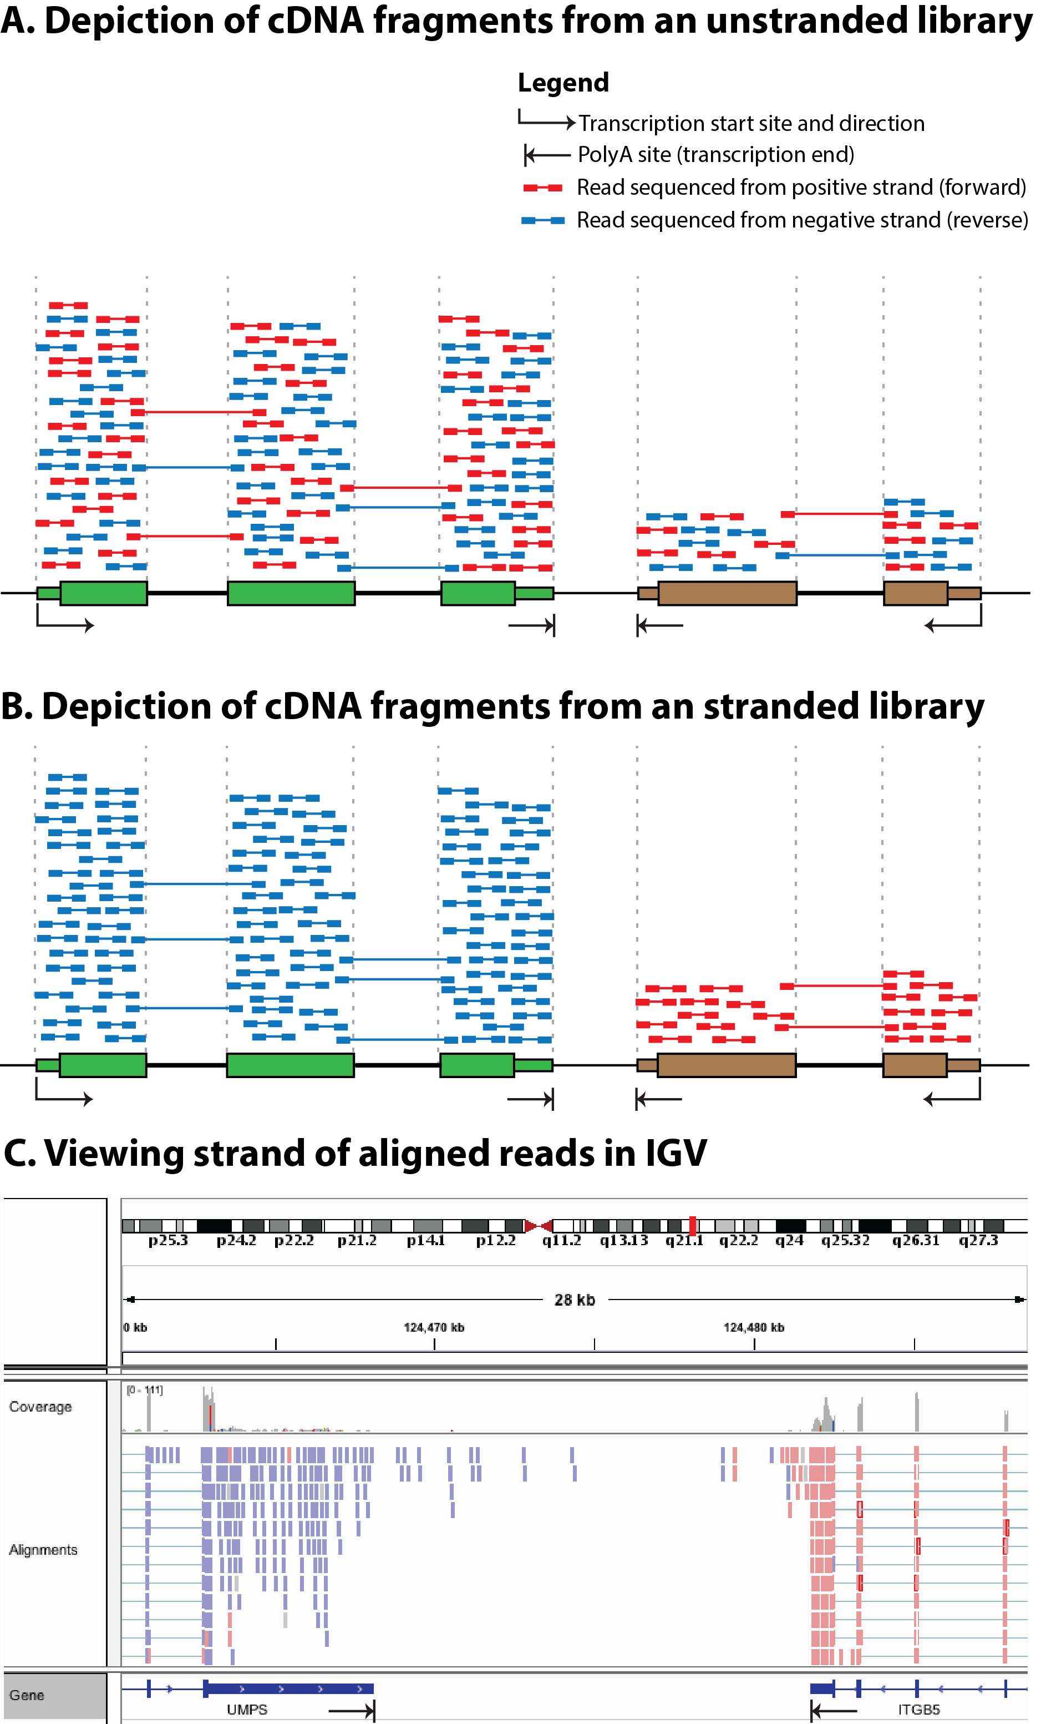
Stranded vs. unstranded
Notes:
Comparison of stranded and unstranded RNA-seq library methods and their influence on interpretation and analysis. (A) Many RNA-seq library construction protocols do not maintain the strand identity of RNA transcripts in the sequence data (S1 Table). In these “unstranded” strategies, doublestranded cDNA is sequenced, and knowledge of the transcription strand of the RNA molecule is lost. This results in an even mix of reads from both strands. In panel A, a gene transcribed on the positive strand is shown in green, a second gene transcribed on the negative strand is shown in brown, and a third gene transcribed on the positive strand (partially overlapping the second gene) is shown in yellow. The first two genes are protein coding with the open reading frame (ORF) portion depicted as thick rectangles and the UTRs depicted as thin rectangles. The third gene is a noncoding RNA gene. Aligned paired-end read sequences (read 1 and read 2) are depicted as short colored bars connected by thin lines. The thin connecting line in each read pair depicts the portion of the cDNA fragment that remains unsequenced when the cDNA fragment is larger than two times the read length. Each read is colored according to the strand sequenced, blue for the positive (forward/sense) strand and red for the negative (reverse/antisense) strand. Using known annotations, the mapped position of each read, and knowledge of exon splicing patterns, the likely transcription strand of some reads can be inferred. However, for many aligned reads the transcription strand cannot be inferred and sense-antisense expression analysis is not possible. Note that for each gene, an approximately equal proportion of reads corresponding to each strand are observed. Also note that read pairing information can sometimes be used to infer which gene a read was likely derived from. These reads are referred to as “encompassing” read pairs, in which one read of a pair aligns within one exon and the second read of a pair aligns within another exon. However, reads that align within a region corresponding to overlapping genes cannot be unambiguously assigned to either gene (e.g., the portion of the brown and yellow genes that overlap). Note that in this figure we are not depicting any reads in which a single read of a read pair spans across an intron. These exon–exon “spanning” reads can usually be matched unambiguously to a transcript, even in an unstranded library, because the exon–exon junction alignments line up with known splice sites and exon boundaries. (B) More recent “stranded” RNA-seq library strategies allow the strand information to be retained. In the resulting alignments, depicted in panel B, the strand of the alignment corresponds in a predictable way to the transcription strand of the sequenced RNA molecule. Now we see that reads aligning within a gene are indicated as being derived from the expected transcription strand for that gene. Furthermore, in regions where two genes overlap on opposite strands, we can now unambiguously assign reads to each gene. (C) When strand information is maintained by the RNA-seq protocol, it can be visualized in genome browsers such as IGV [62]. For example, to make IGV color read alignments according to strand, use the “Color alignments” by “First-of-pair strand” setting (refer to S5 Table for more strand-related software settings).

Slide 12
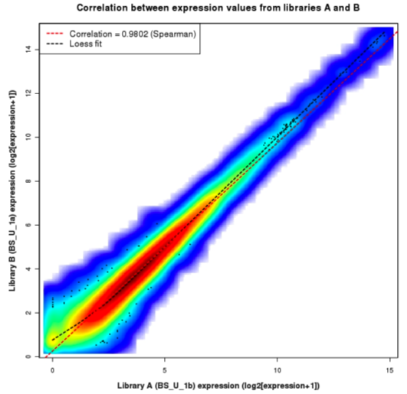
Replicates
Technical Replicate
Multiple instances of sequence generation
Flow Cells, Lanes, Indexes
Biological Replicate
Multiple isolations of cells showing the same phenotype, stage or other experimental condition
Some example concerns/challenges:
Environmental Factors, Growth Conditions, Time
Correlation Coefficient 0.92-0.98

Slide 13
Common analysis goals of RNA-Seq analysis (what can you ask of the data?)
Gene expression and differential expression
Alternative expression analysis
Transcript discovery and annotation
Allele specific expression
Relating to SNPs or mutations
Mutation discovery
Fusion detection
RNA editing

Slide 14
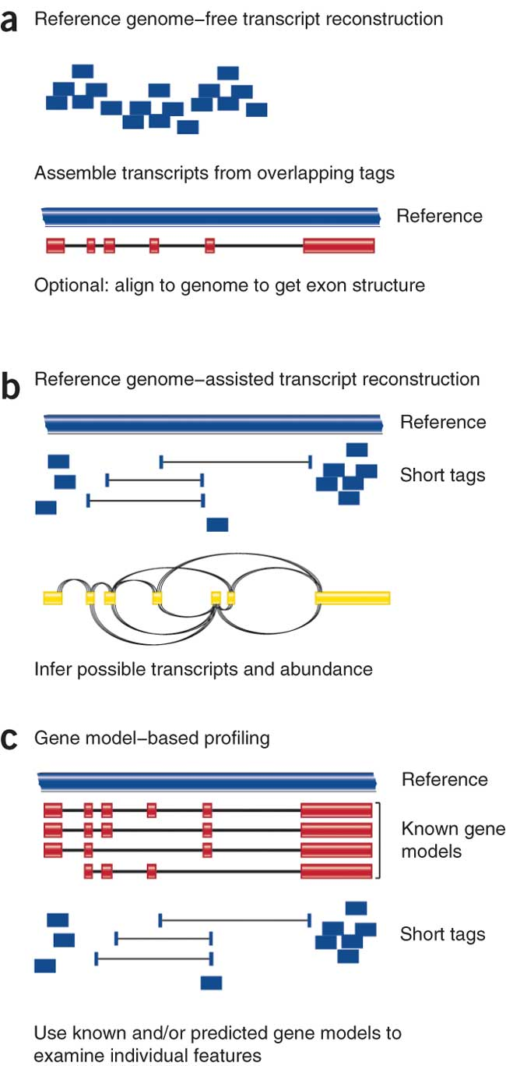
Three RNA-seq mapping strategies
De novo assembly
Align to transcriptome
Align to reference genome
Diagrams from Cloonan & Grimmond, Nature Methods 2010

Slide 15
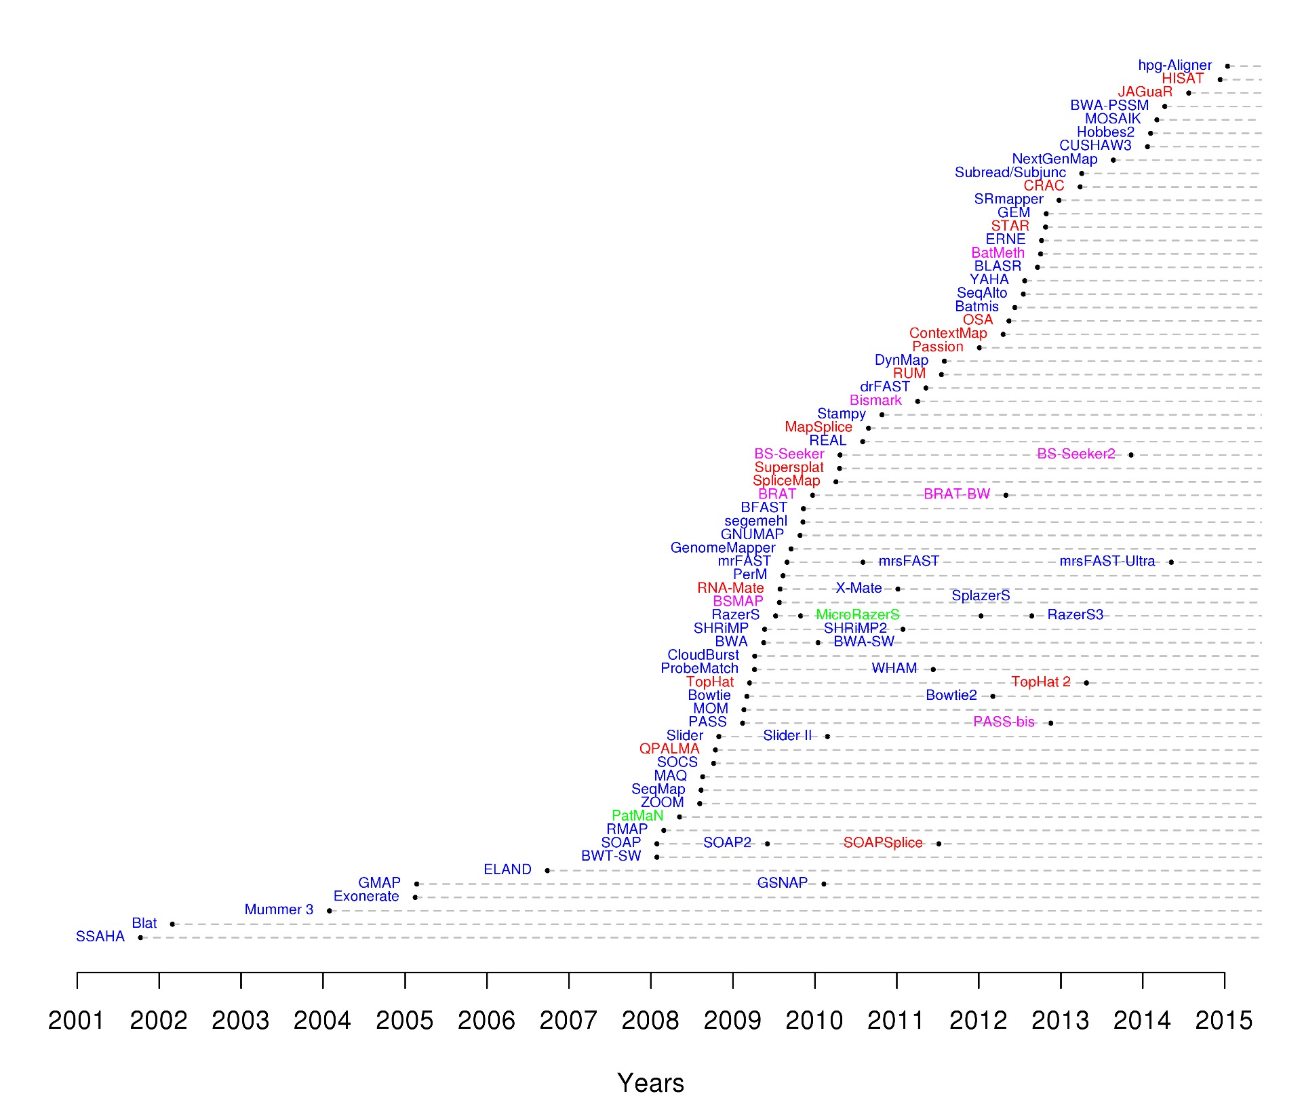
Which read aligner should I use?
RNA
Bisulfite
DNA
microRNA
http://wwwdev.ebi.ac.uk/fg/hts_mappers/

Slide 16
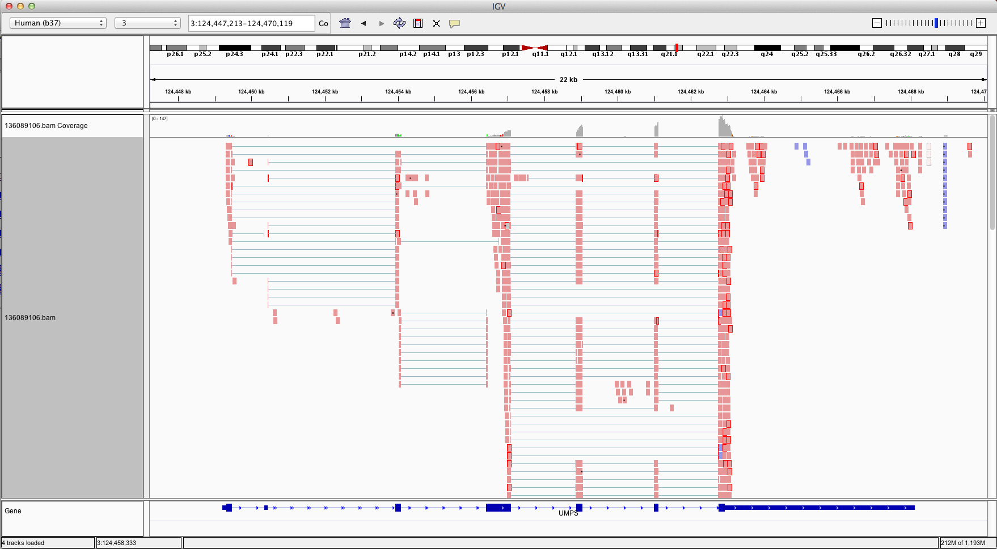
Visualization of RNA-seq alignments in IGV browser
Ideogram
Coverage
pileup
Control pop-up info
Viewer position
Coverage
track
Coverage
scale
Single reads, not spliced
+ve
strand
-ve
strand
Reads track
Single reads, spliced
Gene track

Slide 17
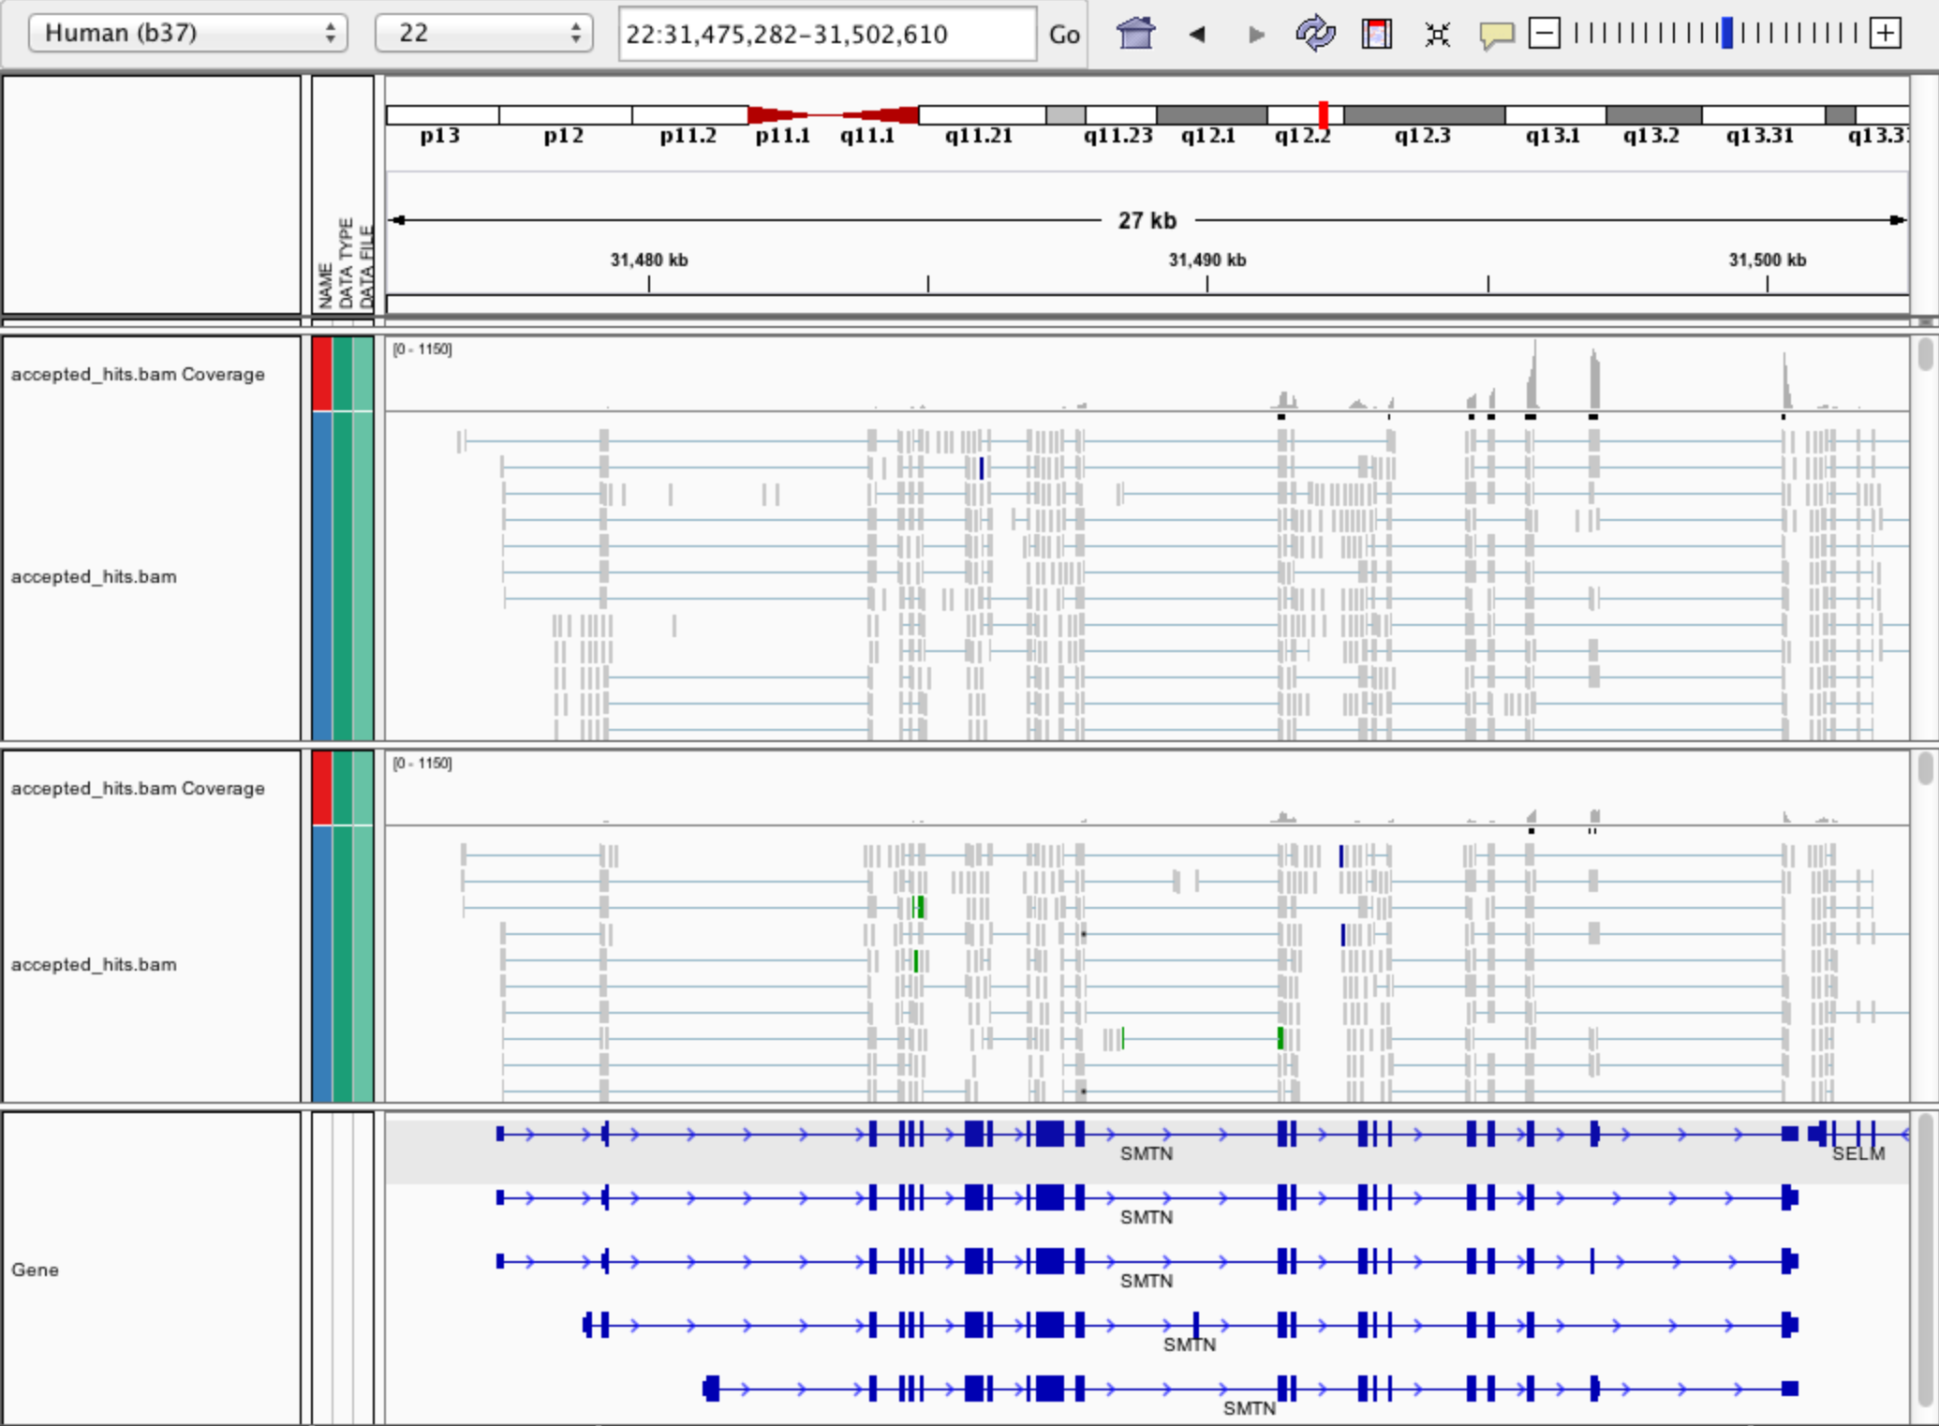
Expression estimation for known genes and transcripts
3’ bias
Down-regulated

Slide 18
What is FPKM (RPKM)
RPKM: Reads Per Kilobase of transcript per Million mapped reads.
FPKM: Fragments Per Kilobase of transcript per Million mapped reads.
In RNA-Seq, the relative expression of a transcript is proportional to the number of cDNA fragments that originate from it. However:
The number of fragments is also biased towards larger genes
The total number of fragments is related to total library depth
FPKM (RPKM) attempt to normalize for gene size and library depth
FPKM (RPKM) = (10^9 * C) / (N * L)
C = number of mappable reads/fragments for a gene/transcript/exon/etc
N = total number of mappable reads/fragments in the library
L = number of base pairs in the gene/transcript/exon/etc
http://www.biostars.org/p/11378/
http://www.biostars.org/p/68126/

Slide 19
How do FPKM and TPM differ?
TPM: Transcript per Kilobase Million
The difference is in the order of operations:
FPKM
1) Determine total library/sample fragment count and divide by 1,000,000
“per million” scaling factor
2) Divide each gene/transcript fragment count by #1
fragments per million, FPM
3) Divide each FPM by length of each gene/transcript in kilobases (FPKM)
TPM
1) Divide each gene/transcript fragment count by length of each gene/transcript in kilobases
fragments per kilobase, FPK
2) Sum all FPK values for the sample and divide by 1,000,000
“per million” scaling factor
3) Divide #1 by #2 (TPM)
The sum of all TPMs in each sample is the same. Easier to compare across samples!
http://www.rna-seqblog.com/rpkm-fpkm-and-tpm-clearly-explained/
https://www.ncbi.nlm.nih.gov/pubmed/22872506
Notes:
When you use TPM, the sum of all TPMs in each sample are the same. This makes it easier to compare the proportion of reads that mapped to a gene in each sample. In contrast, with RPKM and FPKM, the sum of the normalized reads in each sample may be different, and this makes it harder to compare samples directly.

Slide 20
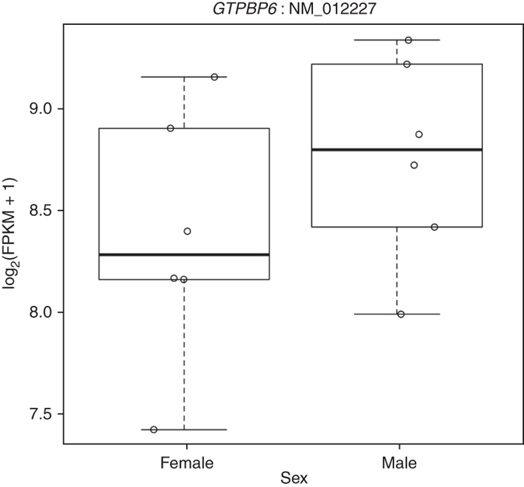
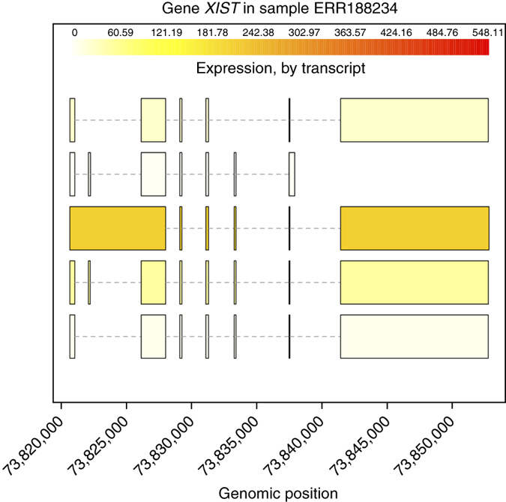
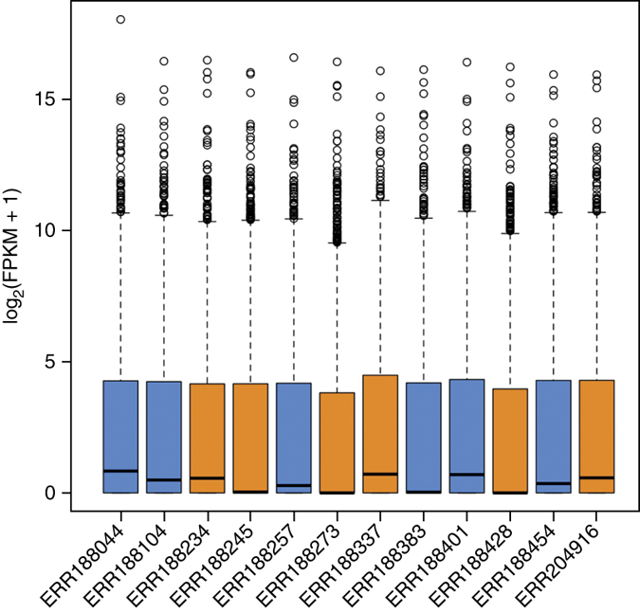
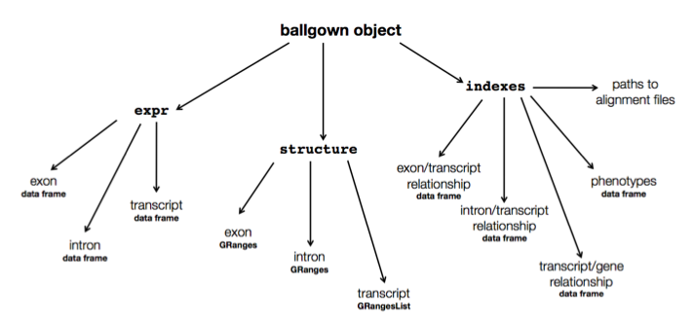
Ballgown for Visualization with R

Slide 21
Learning objectives of module 4
Alignment free estimation of transcript abundance
Introduction to k-mers
Alignment free tools
Sailfish, RNA-Skim, Kallisto, Salmon
Abundance estimation and differential expression analysis with Kallisto and Sleuth

Slide 22
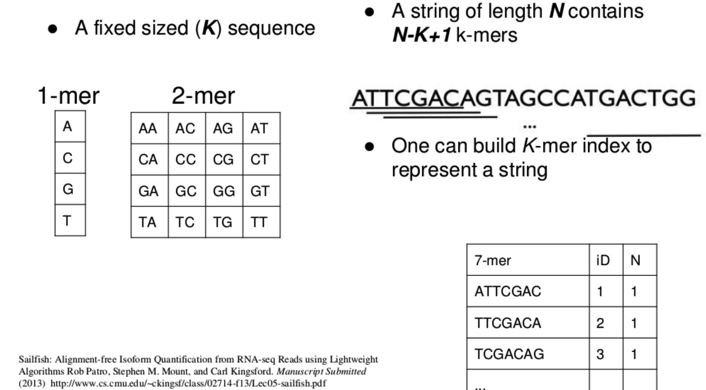
What is a k-mer?
https://www.slideshare.net/duruofei/cmsc702-project-final-presentation
Notes:
As k-mers get longer, there are more possible unique combinations. For k-mers representing strings of DNA sequence there are 4^k possible unique k-mers where k is the length of the k-mer.
Alignment free transcript abundance estimation methods obtain fast performance in part by keeping an index of k-mers in memory. Longer k-mers require more memory.
K-mer length must be shorter than read and transcript lengths to be useful
Default k-mer length for Kallisto is 31

Slide 23
Basic concept of alignment free approaches for transcript abundance
Obtain reference transcript sequences (e.g. Ensembl, Refseq, or GENCODE)
Build a k-mer index of all of the k-mers occurring in each transcript sequence
Store each k-mer and its position within the transcript. “hashing”
Parse all RNA-seq reads and count how many times each k-mer occurs within each read
Model relationship between RNA-seq read k-mers and the transcript k-mer index.
What transcript is the most likely source for each read?
Called “pseudoalignment” , “quasi-mapping”, etc.
Handle sequencing errors, isoforms, ambiguity, and determine abundance estimates
Transcriptome de Bruijn graphs, likelihood function, expectation maximization, etc.

Slide 24
Advantages/disadvantages of alignment free approaches
Advantages
Very fast and efficient
Similar accuracy to alignment based approach but with much, much shorter run time.
Do not need a reference genome, only a reference transcriptome
Disadvantages
You don’t get a proper BAM file
Information in reads with sequence errors may be ignored
Limited potential for transcript discovery, variant calling, fusion detection, etc.

Slide 25
Common alignment free tools
Sailfish
“Sailfish enables alignment-free isoform quantification from RNA-seq reads using lightweight algorithms.” 2014
https://www.ncbi.nlm.nih.gov/pubmed/24752080
RNA-Skim
“RNA-Skim: a rapid method for RNA-Seq quantification at transcript level.” 2014
https://www.ncbi.nlm.nih.gov/pubmed/24931995
Kallisto
“Near-optimal probabilistic RNA-seq quantification.” 2016
https://www.ncbi.nlm.nih.gov/pubmed/27043002
Salmon
“Salmon provides fast and bias-aware quantification of transcript expression.” 2017
https://www.ncbi.nlm.nih.gov/pubmed/28263959

Slide 26
Which is best?
Somewhat controversial …
https://liorpachter.wordpress.com/2017/08/02/how-not-to-perform-a-differential-expression-analysis-or-science/
Various sources suggest that Salmon, Kallisto, and Sailfish results are quite comparable
Usability, documentation, and supporting downstream tools could be used to decide

Slide 27
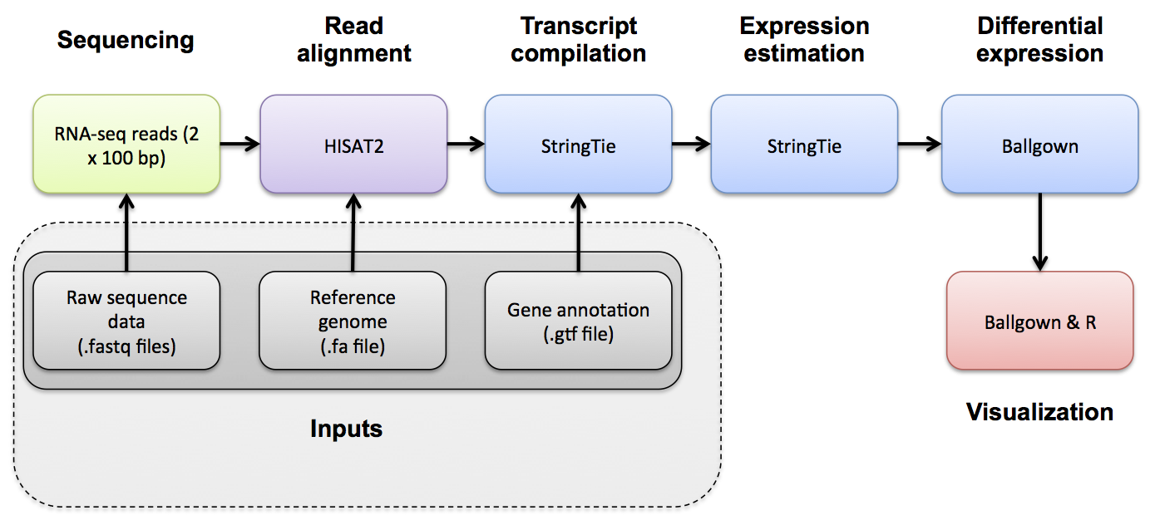
HISAT2/StringTie/Ballgown RNA-seq Pipeline

